Slide 1
Fine-cell and broad-cell sex/APOE key-driver analysis
How mitochondrial DEG queries become non-core-MT network-driver candidates
PART I
PART II
Fine-cell reaggregation
Direct broad-cell KDA
295 included runs → coverage + support + ACAT → 74 candidate units
3 completed runs → within-run BH → 12 direct candidate rows
Notes:
Teaching goal: Introduce the two Phase 20 branches and signal that they use different evidence structures.
Walk through: The fine-cell branch starts with many fine-cell and direction-specific KDA runs and reaggregates them within sex/APOE by broad-network categories. The broad branch starts from donor-level broad-cell DEGs and runs direct direction-specific KDA without ACAT.
Scientific boundary: The two candidate counts are not interchangeable because one is a gene-by-category aggregate unit and the other is a direct gene-by-run row.
Transition: First compare the branches at a glance, then unpack every reduction step separately.

Slide 2
Two branches answer related—but not identical—questions
Both start with mitochondrial DEG queries; only the fine-cell branch combines evidence across runs.
FINE-CELL REAGGREGATION
DIRECT BROAD-CELL KDA
Where does a gene recur across fine-cell evidence?
Which genes pass within one broad-cell direction?
648
295
74
84
3
12
planned directional slots
included KDA runs
gene × category units
planned directional slots
completed KDA runs
direct candidate rows
Groups fine-cell runs within sex/APOE × broad network.
Keeps broad-cell × group × direction results separate.
Uses coverage, individual-run support, ACAT, then category BH.
Uses complete explicit tests and within-run non-core-MT BH.
Final 74 units represent 37 distinct genes in 16 categories.
No coverage, ACAT, recurrence gate, or combined up/down q.
Notes:
Teaching goal: Give the audience a mental map before the detailed funnels.
Walk through: The left card describes cross-run reaggregation from 295 fine-cell runs. The right card describes three direct broad-cell runs. The starting queries are related, but the final units, multiplicity corrections, and interpretation differ.
Scientific boundary: A missing broad candidate is not equivalent to absence from an ACAT aggregate, and a fine candidate unit is not one independent gene-level experiment.
Transition: Begin Part I by defining the counting units used in the fine-cell branch.

Slide 3
PART 1
Fine-cell sex/APOE KDA reaggregation
IN THIS PART
1
Run universe
54 fine cell types define the planned universe; 295 included runs from 41 fine types are aggregated within six groups and seven broad networks.
2
Filter funnel
3
ACAT candidates
4
Result figures
Notes:
Teaching goal: Introduce the fine-cell branch and its sequence from setup to results.
Walk through: The section first defines comparisons, directional slots, KDA calls, included runs, and final candidate units. It then explains DEG construction, run eligibility, complete evidence, coverage, support, ACAT, category BH, and display-only ranking.
Scientific boundary: The branch reconstructs complete evidence from the validated Phase 12 calls at effective query n ≥ 3; it does not rerun KDA or pool sex/APOE groups.
Transition: Start with the four counting units that appear in the funnel.

Slide 4
Four steps
1
2
3
4
DEG comparison
Directional slot
KDA run
Candidate unit
fine cell type × sex/APOE
+ AD-up or AD-down
validated completed call
gene × group × broad network
One signed AD-versus-NCI result
A planned query opportunity
DEG contrast valid and
Effective query n ≥ 3
One or more fine runs; either or both directions
Notes:
Teaching goal: Separate the comparison, slot, run, and candidate-unit concepts before showing counts.
Walk through: Move from left to right. A comparison is one model result. Its sign creates two planned slots. A slot becomes a KDA call when at least three effective query genes remain, and every validated completed call at that execution floor enters the cross-run aggregate. The final unit adds gene identity to group and broad network.
Scientific boundary: The word candidate does not mean mitochondrial DEG. Candidate drivers may be non-DEG, non-mitochondrial network genes.
Transition: Apply those definitions to the complete 648-slot run universe.

Slide 5
54 fine cell types create 648 planned directional slots
Up and down are two query directions from one signed DEG comparison—not two model fits.
54 fine cell types
324 signed results
295 call_key_driver calls
× 6 sex/APOE groups = 324 constrasts
× up/down = 648 directional slots
All valid source and queries ≥3
Mutually exclusive slot outcome
Slots
KDA called?
Source DEG contrast not validated
6
No
Validated source; effective query = 0
246
No
Effective query 1–2
101
No
Effective query 3–9
134
Yes
Effective query ≥10
161
Yes
TOTAL
648
295 calls
Notes:
Teaching goal: Show exactly how 648 planned slots become 295 included KDA runs.
Walk through: The rows are mutually exclusive outcomes derived from the canonical source manifest. Phase 12 calls KDA when at least three effective query genes remain. All 295 completed calls enter Phase 20, including 134 calls with query size three through nine and 161 with at least ten genes.
Scientific boundary: The 6 unavailable slots come from three non-estimable source contrasts times two directions. They are unavailable models, not completed tests with null results. The effective-query-zero row combines absent directional queries and complete loss during network mapping.
Transition: Zoom out once to see how the counting unit changes through the full fine-cell funnel.

Slide 6
Source validity and query size decide whether KDA is called
One canonical query-size gate
What ‘source contrast not valid’ means
≥3
295
The upstream MAST comparison could not be fitted because one arm had fewer than three cells.
included runs with query n>=3
Fine cell type
Group
AD cells
NCI cells
All 295 validated completed calls enter the aggregate.
Fib SLC4A4
M_e2
0
11
CAMs
M_e2
45
1
That includes 295 ≥3.
Mic MKI67
M_e2
2
9
74 completed calls returned no original q≤0.05 gene; they still contribute complete evidence.
3 unavailable comparisons × 2 directions = 6 unavailable slots
Notes:
Teaching goal: Clarify the eligibility statuses and the canonical minimum of three effective query genes.
Walk through: A query of at least three genes allows the Phase 12 call and Phase 20 inclusion. The 134 calls with three through nine genes retain Phase 12's below-ten warning but are included alongside the 161 larger-query calls. The right panel gives the three concrete non-estimable comparisons and shows why they create six unavailable direction slots.
Scientific boundary: Small-query calls use the same KDA and support predicates as larger-query calls, but their smaller queries warrant cautious interpretation. Non-estimability is a data/model condition, not evidence against a biological effect.
Transition: With 295 runs fixed, inspect what one KDA call actually tests.

Slide 7
Mitochondrial query genes
DEG rule
2,864,117
118,297
9,262
tested gene × comparison rows
Passed DEG
core-MT query genes
Detected in ≥10% of AD or NCI nuclei.
58,112 up • 60,185 down
4,258 up • 5,004 down
Within-contrast BH FDR < 0.05.
|log₂ fold change| > log₂(1.3) ≈ 0.379.
NETWORK-BACKGROUND INTERSECTION
9,262 provisional query genes
Positive and negative results form AD-up and AD-down queries.
− 1,329 absent from the run-specific induced background
= 7,933 query genes
Query = DEG rule ∩ core_mito_protein ∩ requested direction
Membership counts can repeat the same gene across contrasts and directions.
Notes:
Teaching goal: Explain how the mitochondrial KDA query is derived from the full fine-cell DEG analysis.
Walk through: The paper-DEG filters first act within each fine-cell by group comparison. Only passing core mitochondrial proteins in the requested sign become provisional query memberships. The matching broad network is induced on genes tested in that contrast, so out-of-background query memberships are removed before run eligibility is assessed.
Scientific boundary: These are membership counts, not unique-gene counts. A query membership also does not mean the gene will be a candidate driver.
Transition: Next distinguish source failure, an empty effective query, a one- or two-gene query, and the canonical three-gene execution floor.

Slide 8
Step 5: a supported unit needs at least one individually convincing run
ACAT significance alone is not sufficient for the primary candidate list.
Supporting-run rule
Non-MT explicit-test sub-funnel
1
other_query_overlap ≥ 2
94,527
19,740
3,613
3,579
864
explicit tests
positive overlap
other overlap ≥2
+ FE >1
+ final q≤0.10
2
fold enrichment > 1
3
final_run_q ≤ 0.10
864 supporting gene × run events
→ 501 gene × category units → 500 after coverage ≥0.50
500 units represent 265 genes across 30 categories
All three must hold in the same run.
Strict support uses final_run_q≤0.05 and yields 593 supporting events.
Notes:
Teaching goal: Explain the individual-run evidence requirement that accompanies cross-run ACAT.
Walk through: The other_query_overlap, fold-enrichment, and final_run_q gates must all pass in one explicit run. The sub-funnel starts from all non-MT explicit tests and ends with 864 supporting gene-by-run events, which collapse to 501 category units before coverage removes one.
Scientific boundary: The support field is reconstructed final_run_q from each run's full explicit family and validated against Phase 12 published returns. It is distinct from original_run_q and from the category q obtained after ACAT and category-specific BH correction.
Transition: Now combine all usable raw P values and explain how the category q is formed.

Slide 9
Step 6A: ACAT combines raw P values; category BH controls FDR within category
The shorthand ‘ACAT q’ contains two separate operations.
1
Run-level raw P values
explicit final_raw_p or implicit P=1
Example unit
Five eligible runs
2
Equal-weight ACAT
missing backgrounds omitted
P = .001, .40, 1, 1, NA
coverage = 4/5 = 0.80
3
category_acat_p
one P per gene × category
ACAT combines [.001, .40, 1, 1]; NA is omitted
4
BH within category
all coverage-qualified genes
category q
relaxed_category_acat_q
BH denominator
5
233,368 units are partitioned into 38 category-specific BH families; each uses its own coverage-qualified genes.
ACAT combines evidence; BH supplies the within-category multiple-testing correction across genes.
Source: phase20_methods.md; phase20_driver_aggregates.tsv.gz; phase20_filter_funnel.tsv
Notes:
Teaching goal: Separate ACAT combination from the subsequent BH correction that creates the category q value.
Walk through: For each gene-category unit, ACAT combines all usable final_raw_p values, including implicit P equals one rows. Missing backgrounds are omitted. The 233,368 coverage-qualified units are partitioned into 38 category-specific BH families, and BH is applied across the genes within each category.
Scientific boundary: ACAT does not combine run-level q values. The BH family is not restricted to genes that already passed the support gate.
Transition: Apply coverage, support, and category-q thresholds to define relaxed, strict, and exploratory outputs.

Slide 10
FINE FUNNEL • FINAL GATES
Step 6B: relaxed, strict, and exploratory tiers answer different questions
The discovery-oriented main list uses less stringent prespecified thresholds than the strict reference.
Gate / output
Relaxed main
Strict reference
Exploratory-only
Coverage
≥ 0.50
≥ 0.80
≥ 0.50
Supporting-run q
≤ 0.10
≤ 0.05
≤ 0.10
Category q
≤ 0.10
≤ 0.05
0.10 < q ≤ 0.20
Candidate units
74
58
15 additional
Distinct genes
37
30
14
Categories
16
15
7
RELAXED FUNNEL
STRICT FUNNEL
DISPLAY FLAGS
259,548 → 233,368 → 500 → 74
259,548 → 216,218 → 332 → 58
Top 5 / top 10 and stability labels do not filter candidates
Notes:
Teaching goal: Define the main, strict-reference, and exploratory thresholds and their yields.
Walk through: The relaxed and strict funnels use parallel coverage, supporting-run, and category-q thresholds. All 58 strict units are contained within the 74 relaxed units. Exploratory-only leads pass the relaxed availability and support gates but have category q between 0.10 and 0.20.
Scientific boundary: Top-five and top-ten flags change presentation only. Stability labels also characterize evidence but do not remove rows from the 74-candidate main list.
Transition: Summarize what the 74 final units represent before showing the two requested figures.

Slide 11
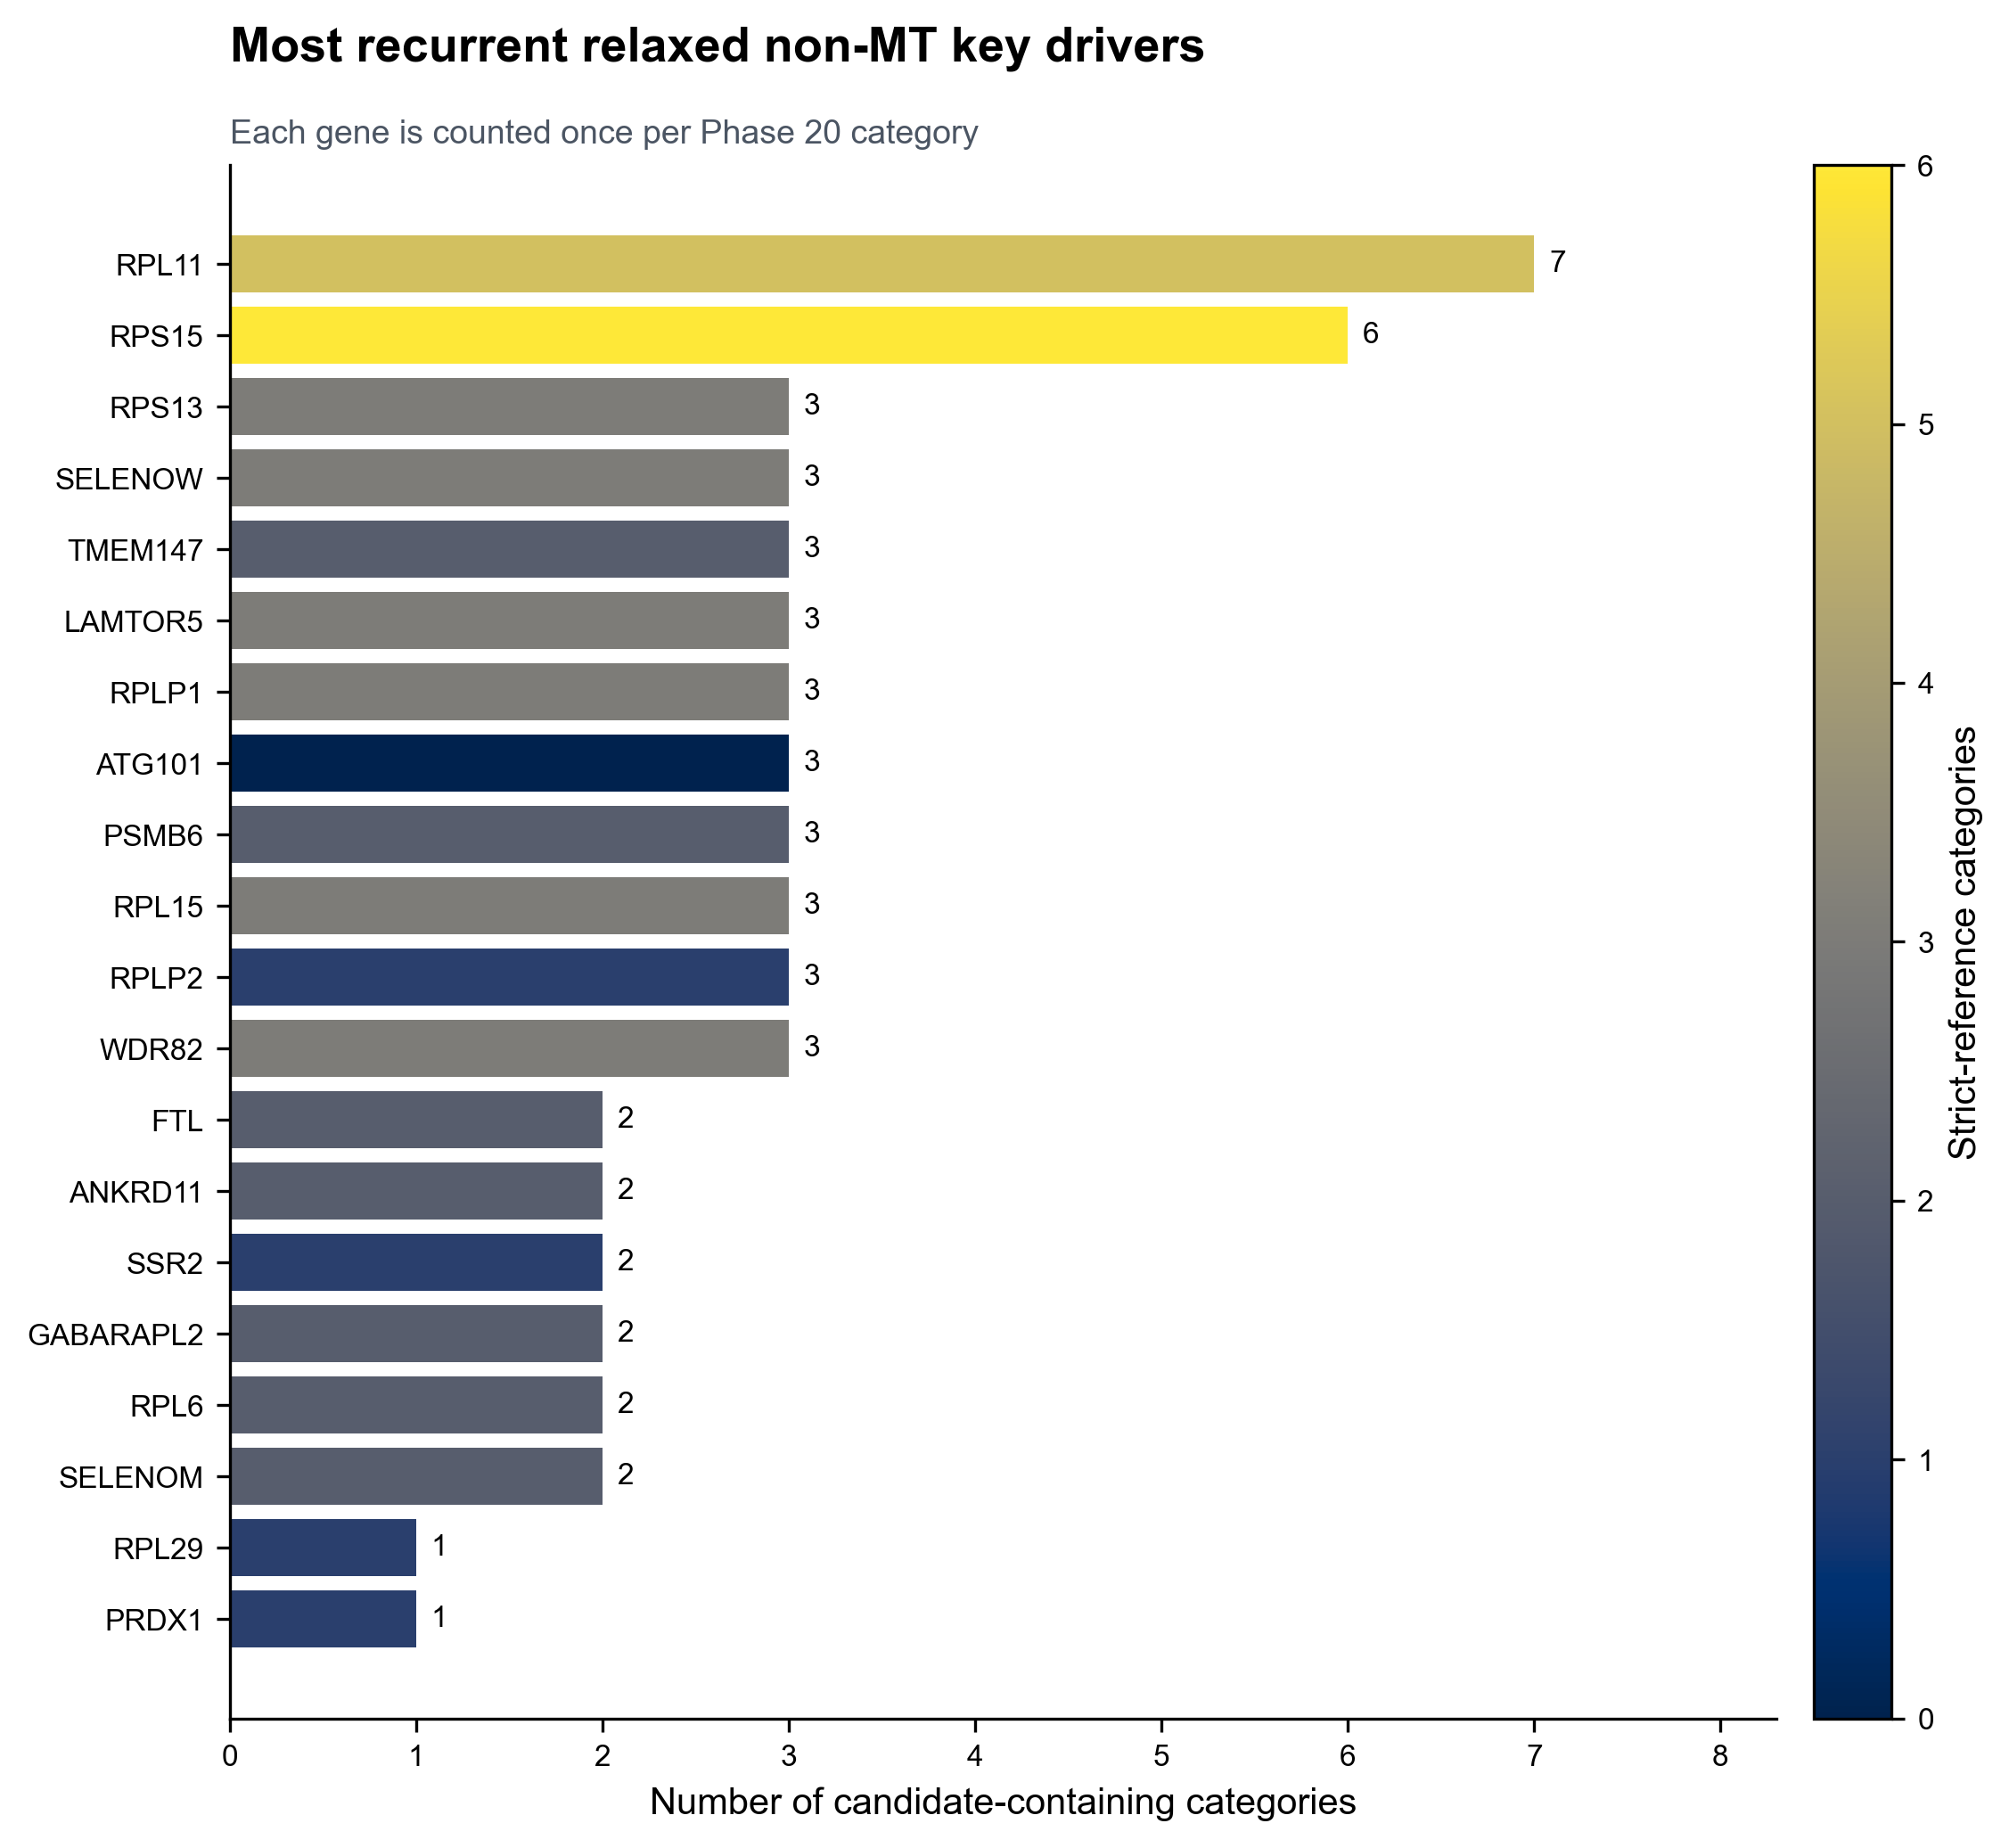
RPL11 recurs across 7 supported categories
Recurrence is descriptive across final sex/APOE × broad-network categories.
How to read it
Bar length = number of final categories containing the gene.
Fill = how many of those categories also pass the strict reference.
RPL11: 7 categories, 4 groups, 4 networks; strict in 5.
RPS15: 6 categories, 4 groups, 3 networks; strict in 6.
The plot shows the top 20 after category count, best q, then symbol ordering.
Not a formal consistency or sex/APOE-difference test.
Notes:
Teaching goal: Interpret the requested fine-cell driver-recurrence figure without confusing categories and runs.
Walk through: The bar reports how many final sex/APOE by broad-network categories contain a relaxed candidate unit for the gene. The fill records strict-category count. RPL11 appears in 7 final categories and RPS15 in 6; the next tier contains genes recurring in three categories.
Scientific boundary: The chart does not count significant fine-cell runs and does not test heterogeneity or consistency across sex/APOE groups.
Transition: The next requested figure shows the ranked presentation subset within supported categories.

Slide 12
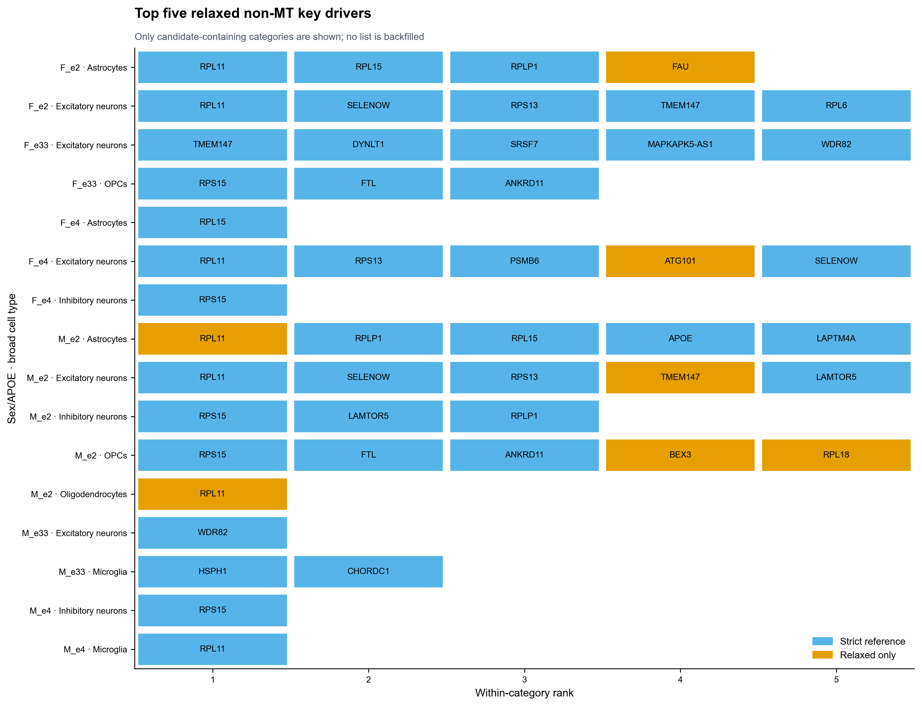
Top-five lists retain up to five candidates per category
Notes:
Teaching goal: Interpret the requested fine-cell top-five tile chart and its ranking rules.
Walk through: Each row is one supported sex/APOE by broad-network category. Candidates are ordered using stored relaxed rank, which follows category q, ACAT P, and gene symbol. At most five are displayed, producing 48 tiles across 16 categories.
Scientific boundary: A blank tile is not backfilled with a failing gene. The plot shows 16 candidate-bearing categories; it omits 22 analyzable categories with no candidate and 4 categories with no included run.
Transition: Part II repeats the setup and funnel explanation for the direct broad-cell branch.

Slide 13
Fine-cell output: 74 candidate units represent 37 distinct genes
74
37
16
58
48
relaxed gene × category units
distinct gene symbols
categories with candidates
strict candidate units
top-five displayed rows
Where candidate units occur
Selected recurrent genes
By sex/APOE group
RPL11
7
M_e2 34 • F_e2 15 • F_e4 11 • F_e33 9 • M_e33 3 • M_e4 2
RPS15
6
RPLP1
3
RPL15
3
By broad network
SELENOW
3
Excitatory 47 • Astrocytes 10 • OPCs 8 • Inhibitory 5 Oligo 1 • Microglia 3 • Vasculature 0
RPS13
3
Examples shown; 10 genes tie at 3 categories. Counts are categories, not runs.
Notes:
Teaching goal: Translate the 74 candidate units into distinct genes, categories, strict support, and display counts.
Walk through: A single gene can occupy more than one category, so 74 units reduce to 37 unique symbols. The visible distributions show where candidate units occur, while the recurrence preview shows which genes appear across the largest number of final categories.
Scientific boundary: Category counts are descriptive and are influenced by unequal included-run availability. They are not tests that one group or network has more biology than another.
Transition: The recurrence figure now displays the top 20 genes by category count.

Slide 14
PART 2
Direct broad-cell sex/APOE KDA
IN THIS PART
1
Run universe
Seven broad cell types are tested directly within six sex/APOE groups; each eligible direction remains its own KDA result.
2
Direct funnel
3
Supported genes
4
Result figures
Source: docs/phase_20_sex_apoe_kda/phase20_broad_funnel_explained.md
Notes:
Teaching goal: Introduce the broad-cell branch as a direct, within-run analysis rather than a reaggregation.
Walk through: This section repeats the setup-to-results sequence for the broad-cell production release. It explains the 42 donor-level DEG contrasts, their 84 directional slots, query formation, the three completed KDA runs, within-run multiplicity correction, and the twelve direct candidate rows.
Scientific boundary: The broad branch does not pool runs with ACAT, calculate cross-run coverage, or require recurrence across broad-cell categories.
Transition: Begin by defining the direct branch's counting units and why its final rows differ from the fine-cell units.

Slide 15
BROAD SETUP
Broad-cell candidates stay attached to one cell type, group, and direction
There is no cross-run aggregation step in the direct branch.
1
2
3
4
DEG contrast
Directional slot
KDA run
Candidate row
broad type × sex/APOE
+ AD-up or AD-down
eligible slot with query n ≥ 3
gene × broad × group × direction
One AD-vs-NCI contrast from a donor-level broad-cell model
A possible core-MT query
One network and one direction
One recomputed non-MT run q
A broad candidate is a gene selected from one direction-specific KDA run—not an ACAT-combined gene.
Source: phase20_broad_funnel_explained.md, analysis-unit definitions
Notes:
Teaching goal: Define the four broad-branch units before presenting the numerical funnel.
Walk through: A donor-level broad-cell model supplies an AD-versus-NCI stratum contrast, whose sign creates two potential core-mitochondrial queries. A slot is called only when at least three query genes remain. Every selected row stays linked to one broad cell type, group, and direction.
Scientific boundary: No candidate row combines an up and down direction or borrows evidence from another broad cell type or group.
Transition: Use those definitions to partition all 84 planned directional slots.

Slide 16
BROAD RUNS
7 broad cell types create 84 slots—but only 3 direct KDA runs
The 84 slots are planned opportunities; they are not 84 executed KDA jobs.
7 broad cell types
42 planned contrasts
3 completed runs
× 6 groups = 42 DEG contrasts
× up/down = 84 predeclared slots
all three use AD-down queries
Mutually exclusive relaxed-tier outcome
Slots
Interpretation
Source DEG contrast not estimable
4
2 contrasts × 2 directions
No provisional directional core-MT query
61
No query genes pass DEG rules
Effective query empty after network mapping
4
All provisional genes are lost
Effective query size 1–2
12
Below direct KDA minimum
Effective query size ≥3
3
KDA completed
TOTAL
84
3 completed runs
Most slots disappear before KDA because the relaxed broad DEG query is absent or too small.
Source: phase20_broad_direction_manifest.tsv; phase20_broad_funnel_explained.md
Notes:
Teaching goal: Show exactly how 84 planned broad directional slots become three completed KDA runs.
Walk through: The five outcomes are mutually exclusive. Four slots inherit two non-estimable source contrasts. Sixty-one have no provisional directional core-MT query, four lose every query gene during network mapping, and twelve retain only one or two genes. The remaining three meet the direct minimum of three genes.
Scientific boundary: A skipped slot has no KDA result. It must not be counted as a completed null run or assigned an artificial p value.
Transition: Zoom out to the two-stage broad funnel: first construct runs, then select genes within each completed run.

Slide 17
BROAD FUNNEL OVERVIEW
Broad-cell funnel at a glance: 84 slots to 12 direct candidate rows
The upper row counts slots; the lower row counts explicit gene tests or candidate rows.
RUN CONSTRUCTION
84
80
19
15
3
directional slots
estimable-source slots
with provisional query
non-empty after mapping
completed KDA runs
Counting unit changes once: slots/runs → explicit gene × run rows
DIRECT CANDIDATE SELECTION
377
362
15
15
12
explicit tested rows
non-core-MT family
query overlap ≥2
fold enrichment >1
within-run q ≤0.10
Within-run BH is calculated before overlap and enrichment gates; there is no ACAT stage.
Source: phase20_broad_filter_funnel.tsv; phase20_broad_direction_manifest.tsv
Notes:
Teaching goal: Give a complete overview of broad run construction and direct candidate selection.
Walk through: The top row shows how source estimability, DEG query availability, network mapping, and the minimum effective query size leave three runs. The lower row begins from all explicit KDA-tested rows, removes core mitochondrial proteins, and then applies support, enrichment, and within-run q thresholds.
Scientific boundary: Percentages should be calculated only within a row and with the correct denominator. The transition from three runs to 377 rows changes the counting unit.
Transition: Return to the source model to explain how donor-level DEGs become provisional broad queries.

Slide 18
BROAD FILTER 1 • DEG QUERY
Donor-level DEG rules leave 65 provisional core-MT memberships
Each donor is a replicate; donor × broad-cell samples require enough nuclei and both diagnosis groups.
786,242
2,336
65
35
3
tested gene × contrast rows
relaxed DEG memberships
provisional core-MT memberships
effective query memberships
eligible directional queries
Source contrast must be estimable
Provisional query rules
Aggregate counts by donor × broad cell type.
edgeR filterByExpr() defines the tested-gene universe.
Keep a donor-cell sample only when it has ≥20 nuclei.
Relaxed DEG: BH q≤0.10 + |log2FC|≥log2(1.2).
Signed 2,336: 983 AD-up + 1,353 AD-down memberships.
Fit 7 shared broad-cell models; test up to 6 stratum contrasts each.
Core-MT intersection: 20 up + 45 down = 65.
Require ≥5 AD + ≥5 NCI donors: 40/42 contrasts are estimable.
Network mapping removes 30; 35 memberships remain.
Broad-cell DEGs can reflect within-fine-type expression and shifts in fine-type composition.
A contrast may be not estimable before testing; this is not a zero-DEG result or shared-model failure.
Source: phase20_broad_funnel_explained.md, source-DEG and query-construction sections
Notes:
Teaching goal: Explain both source estimability and gene-level DEG filtering in the broad branch.
Walk through: One joint edgeR model is fit per broad cell type, with donor-level pseudobulk samples as replicates. filterByExpr defines the tested universe before up to six stratum contrasts are evaluated. Relaxed thresholds yield 2,336 signed memberships; the core-MT intersection yields 65, and network mapping removes 30.
Scientific boundary: Two vascular contrasts fail donor-count eligibility even though the shared vascular model fits; they create four unavailable directions. Broad-cell changes can also mix expression shifts within fine types with fine-type composition shifts.
Transition: Inspect the three surviving directional queries and their exact KDA accounting.

Slide 19
BROAD FILTER 2 • QUERY ELIGIBILITY
Only three relaxed queries reach the direct KDA minimum
All three completed runs are AD-down mitochondrial queries; one completes with no candidates.
Broad × group × direction
Provisional
Effective
Background
Explicit tests
Relaxed rows
Astrocytes × F_e4 × AD-down
18
13
7,828
160
2
Astrocytes × M_e33 × AD-down
5
3
7,828
80
0
OPCs × F_e4 × AD-down
6
4
7,817
137
10
Mapping loss
Minimum size
Valid empty result
These runs start with 29 provisional memberships; 9 are lost in network mapping, leaving 20 effective query genes.
The plan permits n≥3. The n=3 and n=4 runs are flagged small_query_3_9; only Astrocytes F_e4 has n≥10.
Astrocytes × M_e33 completes successfully; its best non-core-MT row has q=0.1195, so zero rows pass q ≤0.10.
Completed-empty is evidence from a valid run; skipped is the absence of a runnable query.
Source: phase20_broad_direction_manifest.tsv; phase20_broad_all_candidate_tests.tsv.gz
Notes:
Teaching goal: Make the three completed broad runs and their query sizes concrete.
Walk through: The table traces provisional core-MT memberships through network mapping, then shows each matching background, explicit-test family, and relaxed-candidate yield. Both Phase 20 branches use the validated execution floor of three effective query genes; the direct n=3 and n=4 runs retain their small-query caution labels.
Scientific boundary: The n=3 and n=4 runs remain labeled small_query_3_9 and warrant extra caution. Astrocytes M_e33 is not a failure: it completed, produced explicit tests, and simply has no row at q≤0.10.
Transition: Explain what the 377 explicit tests represent and why broad multiplicity correction stays within run.

Slide 20
BROAD FILTER 3 • KDA EVIDENCE
Broad KDA evaluates 377 explicit network-neighborhood tests
Only reachable/testable candidate genes receive explicit enrichment tests; the background is not the BH family.
23,473
377
362
11
background gene × run opportunities
explicit KDA-tested rows
non-core-MT BH rows
stock significant returns
3 run-specific backgrounds
160 + 80 + 137
151 + 78 + 133
audit field, not final gate
One explicit row
BH family
What is absent
A gene reachable within 3 undirected hops with a valid directed layer 1–3 neighborhood, explicitly tested against one run's query.
Remove core mitochondrial proteins, then recompute BH separately across every remaining explicit row in that run—before selection gates.
23,096 background opportunities lie outside the explicit family. They are neither failed candidates nor implicit P=1 rows.
11 stock q≤0.05 rows = 9 strict non-core-MT candidates + core-MT GLDC and ME3; final selection uses recomputed q.
Source: phase20_broad_all_candidate_tests.tsv.gz; phase20_broad_direction_manifest.tsv
Notes:
Teaching goal: Explain the broad KDA test universe and the within-run multiple-testing family.
Walk through: Three run-specific backgrounds contribute 23,473 gene-by-run opportunities, but only 377 reachable genes with valid directed neighborhoods receive explicit tests. The other 23,096 are outside the explicit family. Removing fifteen core-MT rows leaves run-specific BH families of 151, 78, and 133.
Scientific boundary: The eleven stock returns include core-MT GLDC and ME3. Excluding them reconciles the stock count to nine strict non-core-MT candidates; stock return status is still only an audit field.
Transition: Apply the biological-support and q gates to the complete non-core-MT families.

Slide 21
BROAD FILTERS 4–6 • CANDIDATE SELECTION
Support and within-run q reduce 362 non-core-MT rows to 12
BH q values are computed on full non-core-MT run families before post-BH gates are applied.
362
15
15
12
9
non-core-MT family
query overlap ≥2
fold enrichment >1
relaxed q ≤0.10
strict q ≤0.05
Non-core-MT
Overlap ≥2
Enrichment >1
Run q
Exclude only core mitochondrial proteins; extended-tier NCOA1 remains eligible.
Require at least two effective query genes inside the candidate's tested neighborhood.
Require more overlap than expected under the run-specific network background.
Relaxed main list uses q ≤0.10; q ≤0.05 marks the strict reference subset.
After defining the non-core-MT family, compute BH before filtering on overlap, enrichment, or q.
Source: phase20_broad_filter_funnel.tsv; phase20_broad_non_mt_candidates.tsv
Notes:
Teaching goal: Explain every direct broad candidate gate and its numerical effect.
Walk through: Core-MT genes are first removed to define the inferential family. Fifteen of 362 non-core-MT rows overlap at least two query genes; all fifteen have enrichment above one. Twelve pass q≤0.10 and nine pass q≤0.05. BH was computed across each full non-core-MT run family before these gates.
Scientific boundary: NCOA1 is labeled mitochondrial-extended but is not a core mitochondrial protein, so it legitimately remains in the non-core-MT candidate universe.
Transition: Name the supported genes and separate strict rows, relaxed-only rows, and the completed-empty run.

Slide 22
BROAD RESULTS • SUPPORTED GENES
Twelve broad candidates occur in two runs; nine pass the strict reference
AD-down labels the mitochondrial query direction; candidate drivers need not be downregulated or DEGs.
Astrocytes • F_e4 • AD-down
Astrocytes • M_e33 • AD-down
OPCs • F_e4 • AD-down
2
0
10
relaxed • both strict
completed-empty
relaxed • 7 strict
ELL2 SLC44A3
No q ≤0.10 rows
STRICT
CAMK2D • RAPGEF4 • RAB3IP • FOXN3 AC092691.1 • FAM13A • NCOA1
Best row: NEK6, q=0.1195. The run completed successfully.
RELAXED-ONLY
Both supported by AHCYL1 and PNPLA8 overlap.
FGF14 • GRID1 • DENND1A
The broad result is 12 unique genes because none recurs across the two candidate-bearing runs.
Source: phase20_broad_non_mt_candidates.tsv; phase20_broad_direction_manifest.tsv
Notes:
Teaching goal: List every supported broad candidate and make the tier distinction explicit.
Walk through: The Astrocytes F_e4 run contributes two strict candidates. Astrocytes M_e33 is a valid completed-empty run. OPCs F_e4 contributes ten relaxed candidates: seven strict and three relaxed-only. Because the two candidate-bearing runs share no gene, twelve rows also equal twelve unique symbols.
Scientific boundary: AD-down identifies the mitochondrial query direction. It does not assert that the candidate driver itself is downregulated or is a DEG.
Transition: Use the requested recurrence-style figure to show that q strength, rather than cross-run recurrence, differentiates these genes.

Slide 23
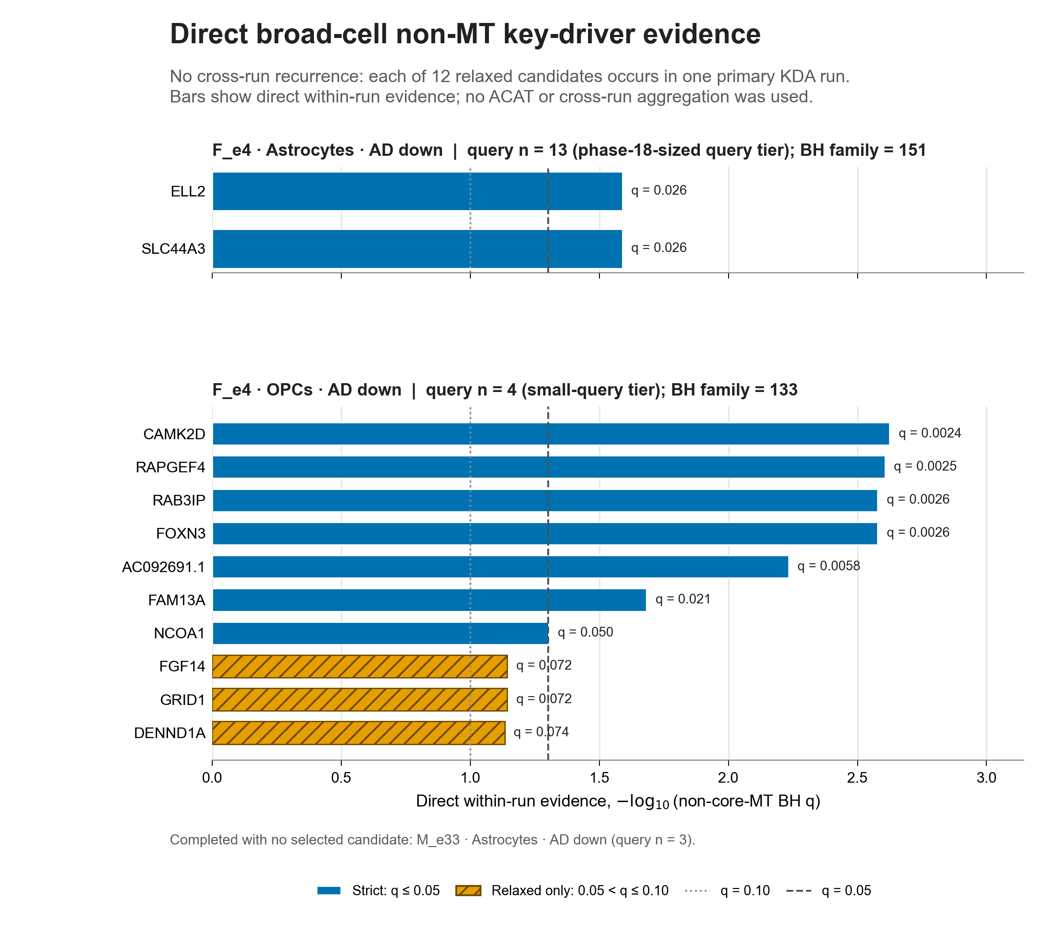
BROAD RESULTS • DRIVER RECURRENCE
Broad candidates do not recur across runs; bars show within-run q strength
This recurrence analogue keeps all 12 unique genes and encodes −log10(non-core-MT run q).
How to read it
Each gene appears in exactly one completed broad run.
Bar length = −log10(non-core-MT run q), not recurrence count.
Run labels/panels identify Astrocytes F_e4 versus OPCs F_e4.
Blue = strict q≤0.05; hatched orange = relaxed-only.
Nine genes are strict q ≤0.05; three OPC genes are relaxed-only.
Astrocytes M_e33 is absent because its candidate list is empty.
No broad recurrence gate was applied.
The figure answers ‘how strong within this run?’—not ‘in how many runs did this gene recur?’
Source: results/figures/analysis/phase_20_sex_apoe_kda_broad/driver_recurrence figure bundle
Notes:
Teaching goal: Interpret the requested broad recurrence-style figure without implying cross-run recurrence.
Walk through: All twelve candidate symbols are unique to one candidate-bearing run. Bar length shows minus log ten of recomputed within-run q; run headings separate Astrocytes F_e4 and OPCs F_e4. Blue bars pass strict q≤0.05, while hatched orange bars are relaxed-only.
Scientific boundary: This is not evidence that candidates reproduce across groups, directions, or networks, and no recurrence threshold enters the broad candidate definition.
Transition: The next requested figure applies the display-only top-five limit within each completed broad-cell × group × direction run.

Slide 24
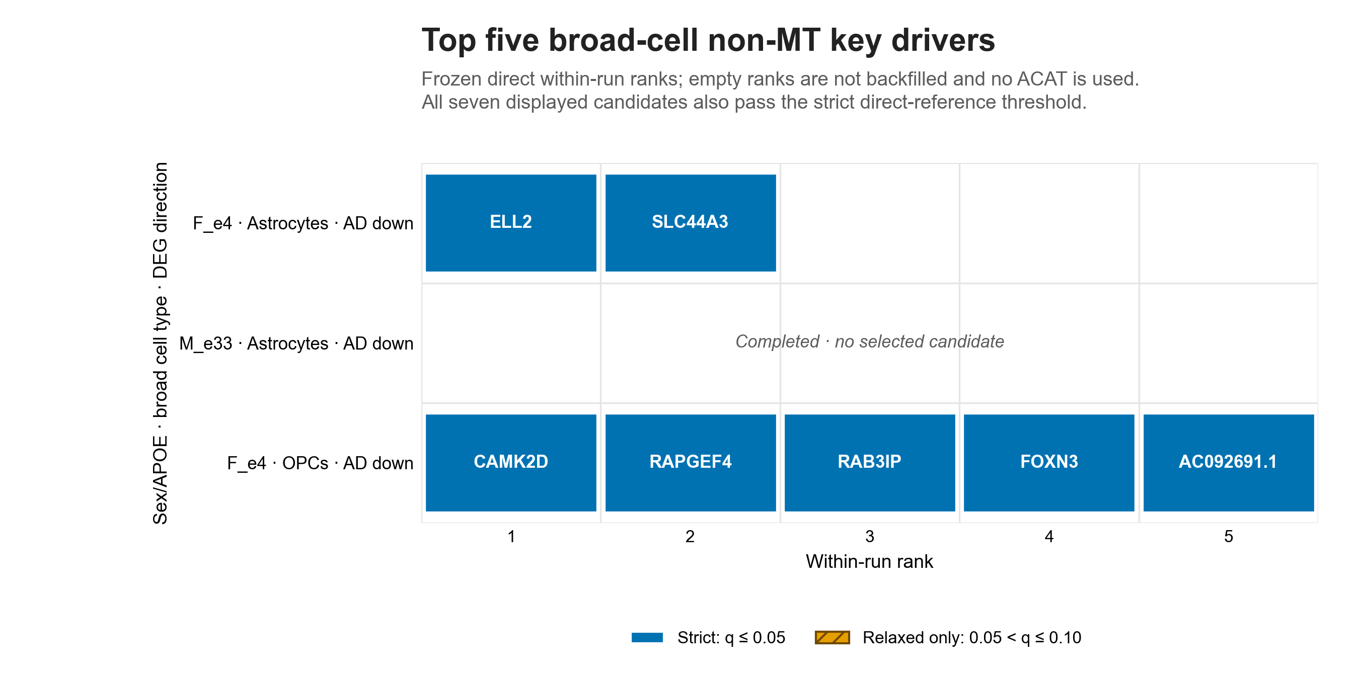
BROAD RESULTS • TOP-FIVE CANDIDATES
The broad top-five view displays 7 strict candidates across 3 run rows
Two Astrocyte candidates, five OPC candidates, and a deliberately blank completed run.
Display contract
7
3
displayed candidates
completed run rows
Order: q, raw P, larger overlap, larger enrichment, then symbol.
All seven displayed genes pass strict q ≤0.05.
Up to five are shown per run; no failing row is backfilled.
The full candidate table still contains all 12 relaxed rows.
The blank M_e33 row makes a valid zero visible; the top-five cap changes presentation only.
Source: results/figures/analysis/phase_20_sex_apoe_kda_broad/top5_candidates figure bundle; phase20_broad_top5_summary.tsv
Notes:
Teaching goal: Interpret the requested broad top-five tile chart and its blank completed run.
Walk through: The figure keeps one row for each completed broad-cell by group by direction run. Astrocytes F_e4 contributes two tiles, Astrocytes M_e33 stays blank, and OPCs F_e4 contributes its first five ranks. Ranking uses q, raw P, larger overlap, larger fold enrichment, then symbol.
Scientific boundary: Only five of the ten relaxed OPC candidates are visible. The remaining five are not removed from the production candidate table, and the blank row is not filled with a q-failing gene.
Transition: Close by comparing the two branches filter by filter and stating what may be concluded from each.

Slide 25
SYNTHESIS
The same words can refer to different evidence in the two branches
Use branch, counting unit, and multiplicity method together when reporting a result.
Question
Fine-cell reaggregation
Direct broad-cell KDA
Starting design
54 fine types × 6 groups
7 broad types × 6 groups
Planned directions
648 slots
84 slots
KDA execution rule
Called at effective query ≥3
Called at effective query ≥3
Analysis inclusion
All completed query ≥3: 295 runs
All completed query ≥3: 3 runs
Evidence completion
Explicit + implicit P=1 + absent
Explicit KDA rows only
Multiple testing
ACAT across runs, then category BH
BH separately within each run
Support requirement
≥1 supporting run (q≤.10 main)
Overlap ≥2 in that run
Final main result
74 gene × category units / 37 genes
12 gene × run rows / 12 genes
Direction meaning
Both directions may feed a category
One retained direction per row
Fine asks whether evidence combines across eligible fine runs; broad asks whether one direct run supports the gene.
Source: validated fine and broad production status, run-manifest, and funnel tables
Notes:
Teaching goal: Put every potentially confusing term side by side across the two branches.
Walk through: The comparison highlights the shared directional query construction and minimum effective query size of three, then shows where the branches diverge. Fine analysis retains all 295 completed directional calls and creates complete cross-run evidence for ACAT: explicit tests, implicit P=1 rows, and absent-from-background states. Broad analysis retains its three direct runs and controls multiplicity within each explicit family.
Scientific boundary: The final counts should never be pooled, ranked against each other, or interpreted as equivalent evidence units.
Transition: End with the core interpretation rules and the exact production artifacts that support the deck.

Slide 26
TAKE-HOME
Take-home: follow the unit, then the filter, then the q value
The deck is a teaching layer over validated, auditable production tables and current canonical figures.
A run is one cell type × sex/APOE × direction KDA analysis.
1
A planned slot becomes a run only when the effective query meets that branch's execution rule.
Audit trail
Fine branch
A candidate is a network gene—not necessarily a DEG or query gene.
phase20_status.tsv phase20_filter_funnel.tsv phase20_relaxed_candidates.tsv
2
Its neighborhood is enriched for the mitochondrial query; AD-up/down labels the query direction.
Fine and broad q values answer different questions.
Broad branch
3
phase20_broad_status.tsv phase20_broad_filter_funnel.tsv phase20_broad_non_mt_candidates.tsv
Fine combines run p values with ACAT then controls category BH; broad controls BH within one run.
Skipped, completed-empty, and filtered-out are distinct outcomes.
4
Unavailable models and unrunnable queries carry no KDA evidence; completed rows can validly yield zero candidates.
Speaker notes on every slide preserve teaching goals, interpretation boundaries, and transitions.
Report the final unit explicitly: 74 fine gene × category units versus 12 broad gene × run rows.
Source: validated Phase 20 fine and broad production releases; canonical figure bundles
Notes:
Teaching goal: Leave the audience with four interpretation rules and a compact audit-source map.
Walk through: Reinforce that run, query, and candidate are different objects. Then emphasize that q values are branch-specific, and that unavailable, skipped, completed-empty, and statistically filtered outcomes must stay distinct. The source card identifies the central production tables behind all stated counts.
Scientific boundary: The deck summarizes association and network-enrichment evidence. It does not establish causal regulation or formal sex-by-APOE interaction effects.
Transition: Use the linked production tables for row-level follow-up and the canonical PNG bundles for figure-specific provenance.

